Slide 1

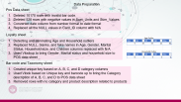

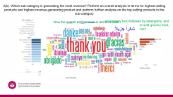
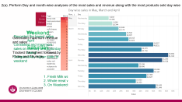
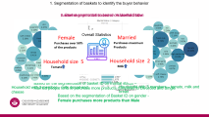
MS5106: Data Science and Big Data Analytics
Assignment 2
Student Name | Student ID
Dilip Venkatesan Sankar | 22225743
Vigneswaran Raja | 22224111
Swathi Babu | 22210391
Introduction
Data Preparation
Data Segmentation
Data Visual Question1
Data Visual Question2

Slide 2



The Objective
Analyze the retail dataset
Derive business insights
Help in decision making
Dataset
POS DATA
LOYALTY
BARCODES
Product Taxonomy
Vigneshwaran Raja
Student ID: 22224111
Swathi Babu
Student ID: 22210391
Dilip Venkatesan Sankar
Student ID: 22225743

Slide 3

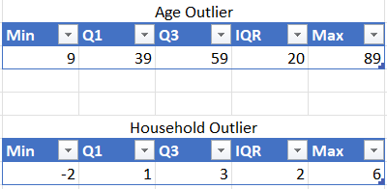
Data Preparation
Pos Data sheet
Deleted 10170 rows with invalid bar code.
Deleted 528 rows with negative values in Sum_Units and Sum_Values
Converted date column from number format to date format
Replaced all the NULL values in Card_ID column with N/A
Loyalty sheet
Detecting and eliminating Age and Household outliers
Replaced NULL, blanks, and fake names in Age, Gender, Marital Status, Household size, and Children columns replaced with N/A
Used Vlookup to bring Gender, Marital status and household size to POS data sheet
Bar code and Taxonomy sheet
Created unique key based on A, B, C, and D category columns
Used Vlook based on Unique key and barcode up to bring the Category description of A, B, C, and D to POS data sheet
Removed rows with no category and product description related to products

Slide 4
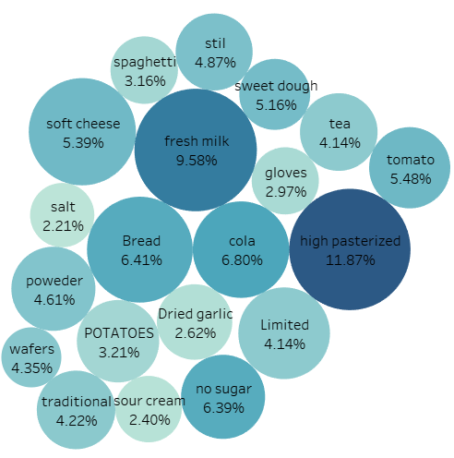
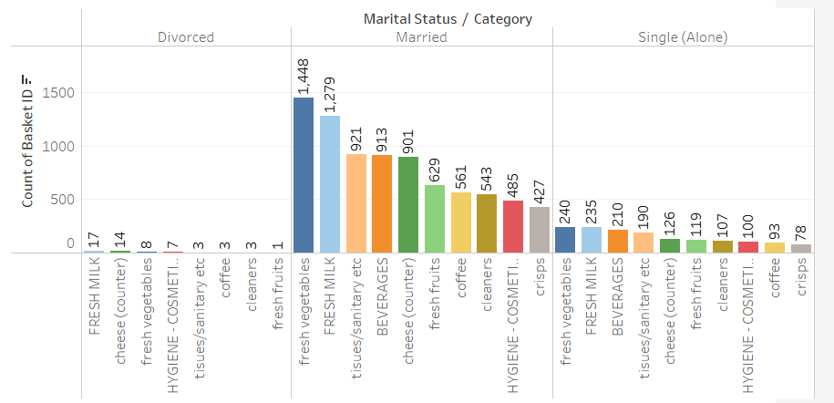
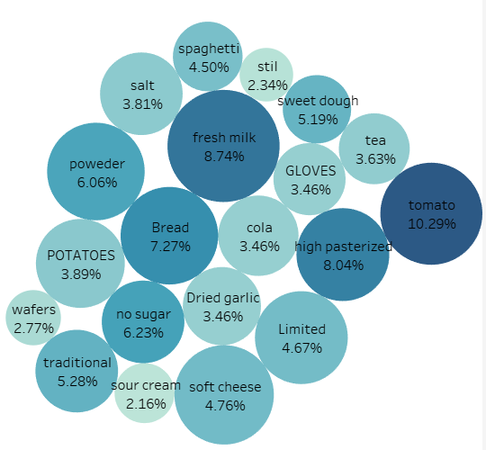
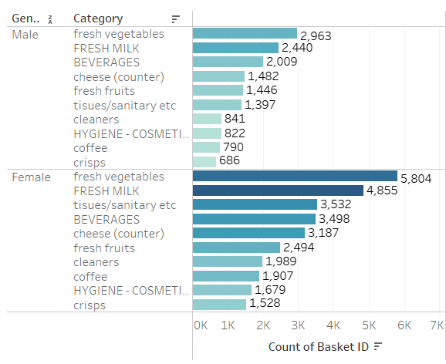
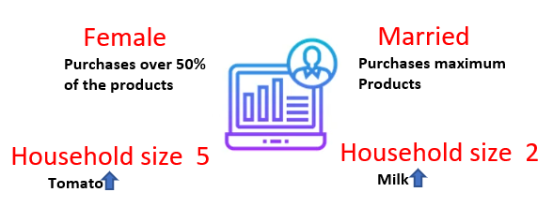
1. Segmentation of baskets to identify the buyer behavior
Basket segmentation based on Marital Status
Basket segmentation based on Household size
Basket segmentation based on gender
2 Members Vs 5 Members
Overall Statistics
Based on the segmentation of basket ID on marital status –
Married people tend to purchase more products compared to Divorced and Single
Household with 2 member – milk, bread and cheese
Household with 5 members – tomato, milk and bread
Based on the segmentation of Basket ID on gender - Female purchases more products than Male

Slide 5
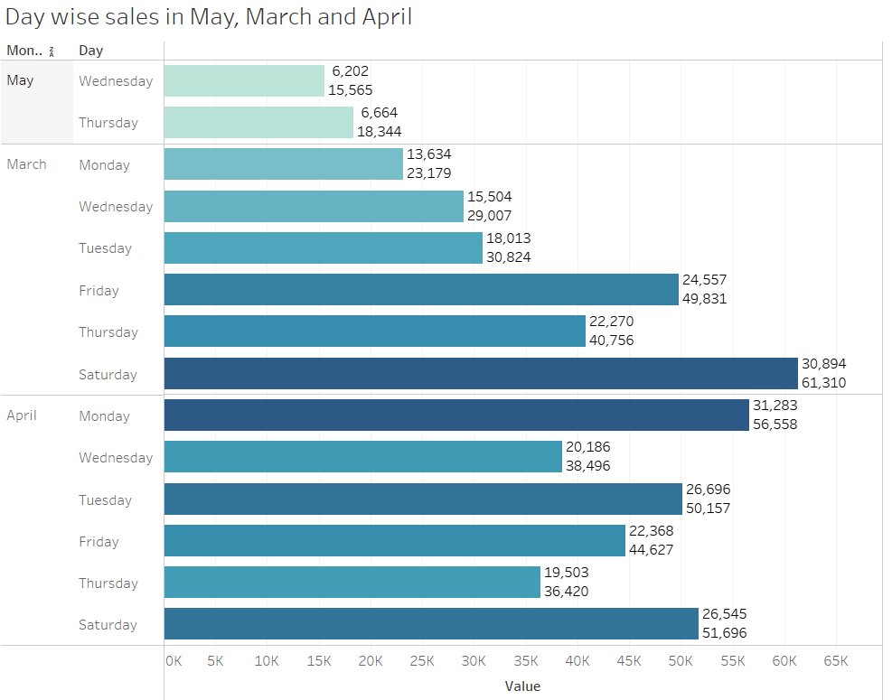
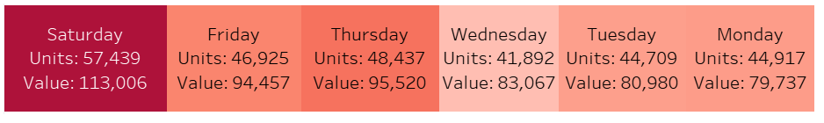
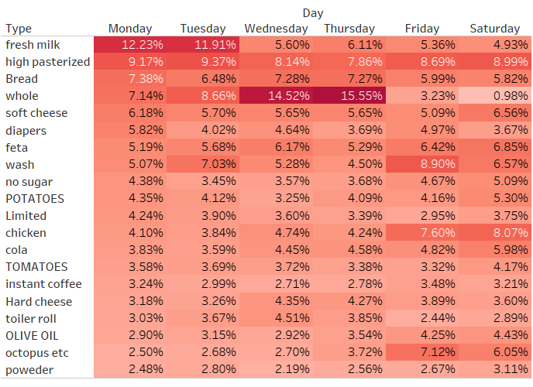
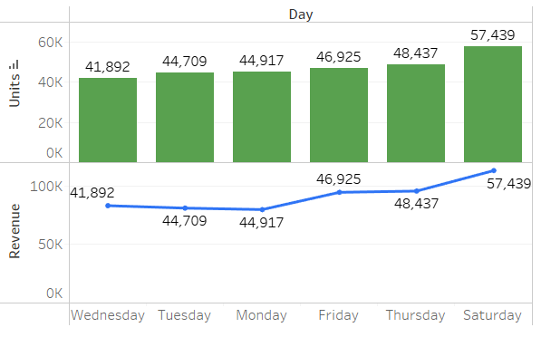
2(a). Perform Day and month-wise analyses of the most sales and revenue along with the most products sold day wise
Weekend
Generated maximum revenue and sales
Saturday
Tracked the highest followed by Friday and Thursday
May
Recorded the lowest sales
April
Consistent and maximum sales on Monday and Saturday
March
Comparatively higher sales in weekend
1. Fresh Milk was highest sold on Monday and Tuesday
2. Whole meat was highest sold on Wednesday and Thursday
3. On Weekends Chicken sold highest

Slide 6
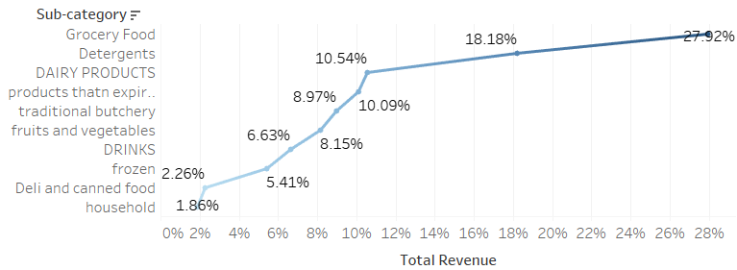

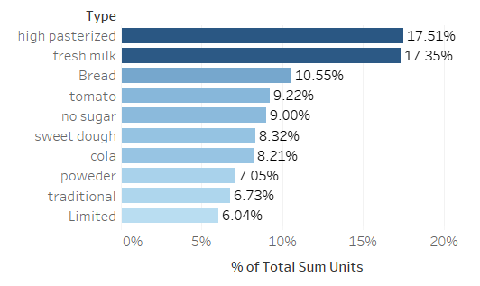
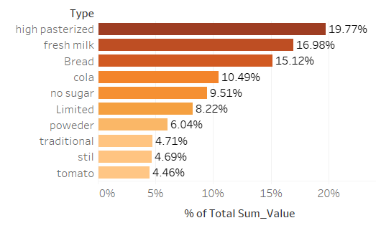
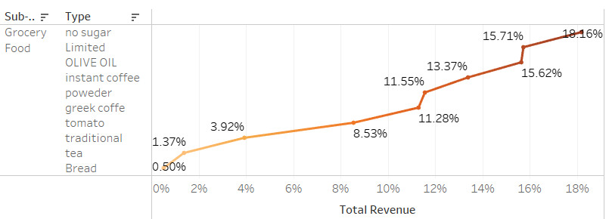
2(b). Which sub-category is generating the most revenue? Perform an overall analysis in terms for highest-selling products and highest revenue-generating product and perform further analysis on the top-selling products in the sub-category
Now the overall performance in terms of units sales and revenue generation
Its Grocery food followed by detergents, and which are the top 10 most sold grocery food, generating highest revenue?
Its no-sugar products
This Photo by Unknown Author is licensed under CC BY-SA

